Slide 1
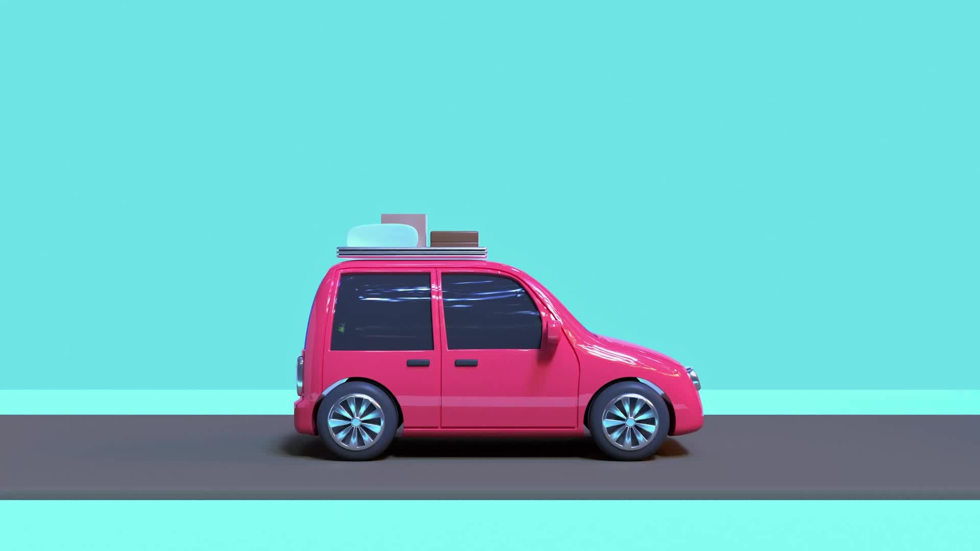
Project: Tiny TOY CARS
BY: Asonye Ajachukwu, asad muhammad, yuxin yang, fatou senghor,Yuqi hao

Slide 2
Introduction -Asad Muhammad
In this project we were supposed to perform the motions of different color cars towards their matching color parking respectively by using some techniques, algorithms and methods that will make them able to adapt the shortest path to reach thier destinations(Same colored Parking) from their sources.
The project required us to build a background comprised of several rooms each with in/out gates and parking, the placement and motion of the cars and the simulation as well

Slide 3
Introduction -Asad muhammad
The main components required for this project are,
-The geometric algorithms to construct the background.
-Constructing a regular Delaunay mesh.
-The Voronoi diagram.
-Building Gates, Toy cars and Car parks.
-Toy car motion.
-Simulation of the toy cars motions.

Slide 4
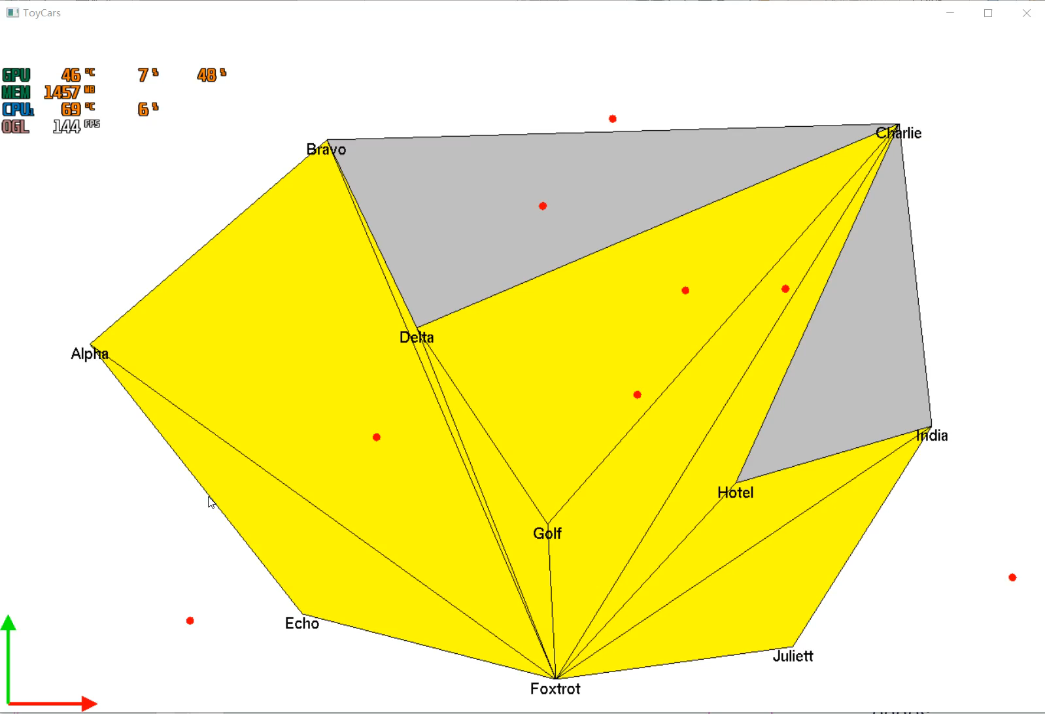
Delaunay Graph - Fatou senghor

Slide 5
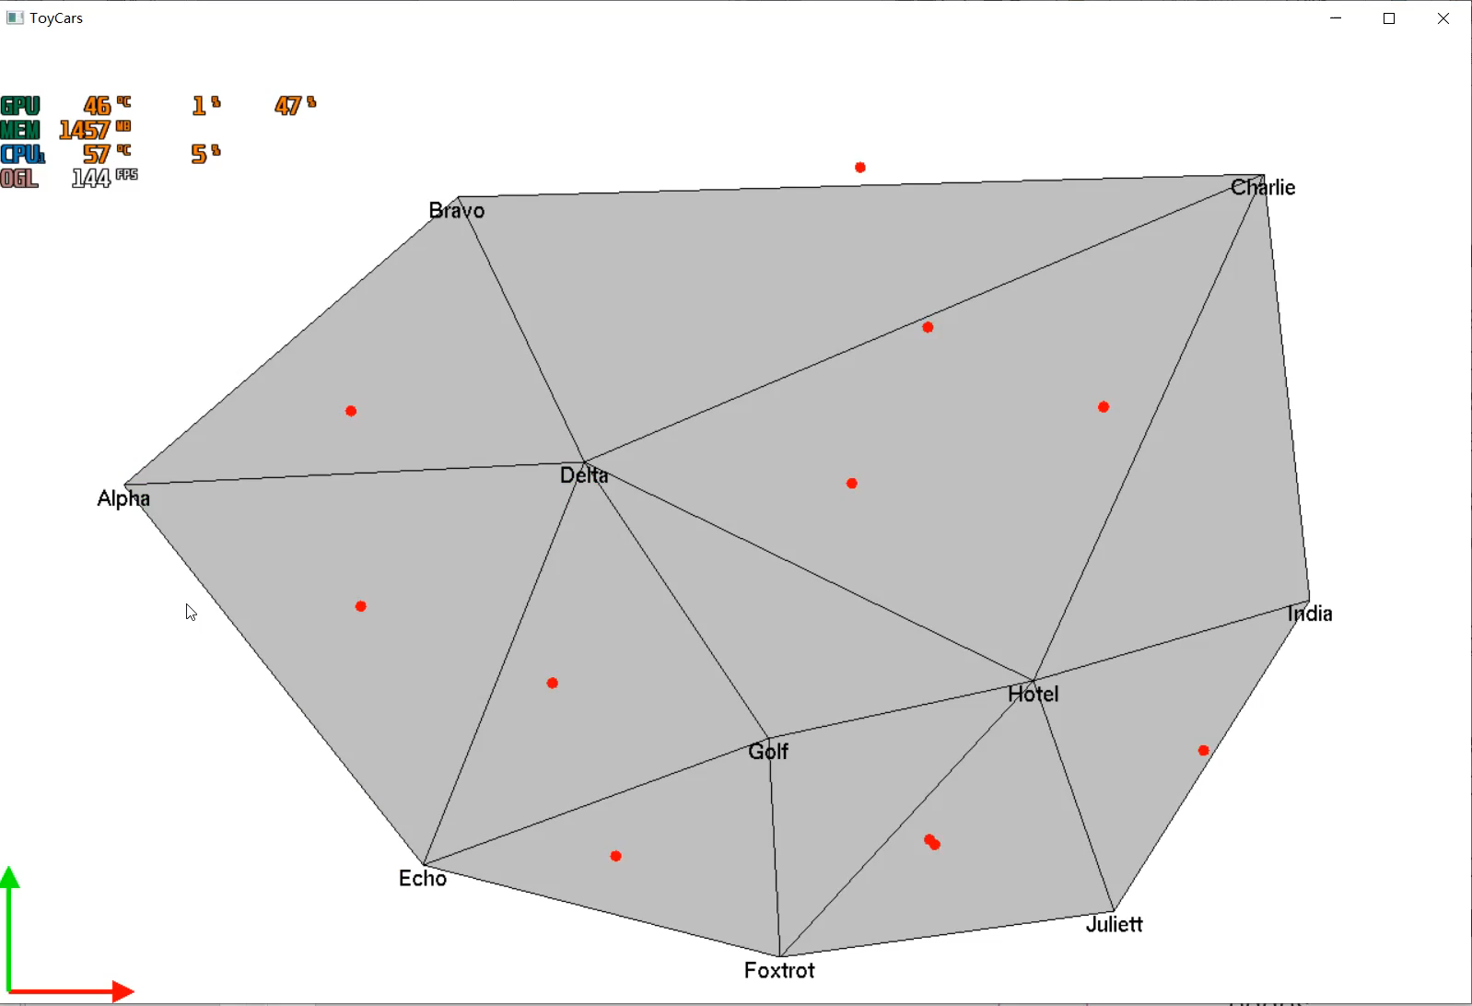
Voronoi -Yuqi hao

Slide 6
Voronoi -Yuqi hao
For this part,
we use a list of Vector2D ‘
and read i,i+1,i+2 each time.
It’s the triangulation we
did in polygon before.
The steps to establish a Voronoi diagram are:
(1) Discrete points automatically construct a triangulation, that is, a Delaunay triangulation. Number the discrete points and the formed triangles, and record which three discrete points each triangle is composed of.
(2) Calculate the center of the circumcircle of each triangle and record it.
(3) Traverse the triangle linked list to find the adjacent triangles TriA, TriB and TriC that are common to the three sides of the current triangle pTri.
(4) If found, connect the outer center of the found triangle to the outer center of pTri and store it in the voronoi edge list. If it is not found, find the outermost plumb line and store it in the voronoi edge list.
(5) At the end of the traversal, all the Voronoi edges are found, and the Voronoi diagram is drawn based on the edges.
The determinant.cpp
and .h provided before
Set the color
as we did in Delaunay
Use an array to distinguish
each color, and in this way
It’s easy to use each
color

Slide 7
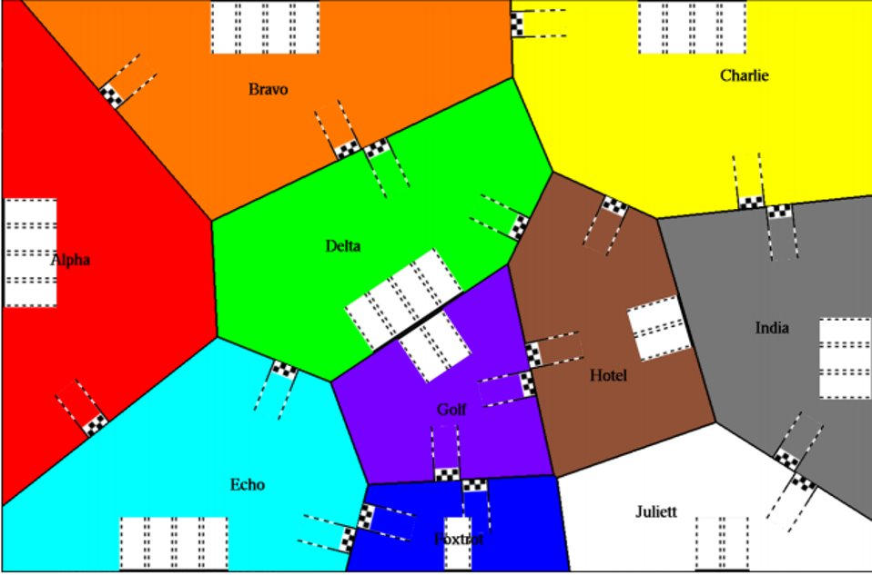
Texturing -yuxin Yang

Slide 8
Texturing -yuxin yang
A texture is an OpenGL Object that contains one or more images that all have the same image format.
The basic idea of texture mapping is to first specify the appropriate texture coordinates for each vertex in the primitive, and then determine the selected texture area in the texture map through the texture coordinates, and finally map the content of the selected texture area to the specified primitive according to the texture coordinates.
In this project, we need to place of gates and car park by using the connection graph.
Also, we need to place of gates and car park by using the connection graph.(The picture is copied from the pdf, just inform, delete the sentence.)

Slide 9
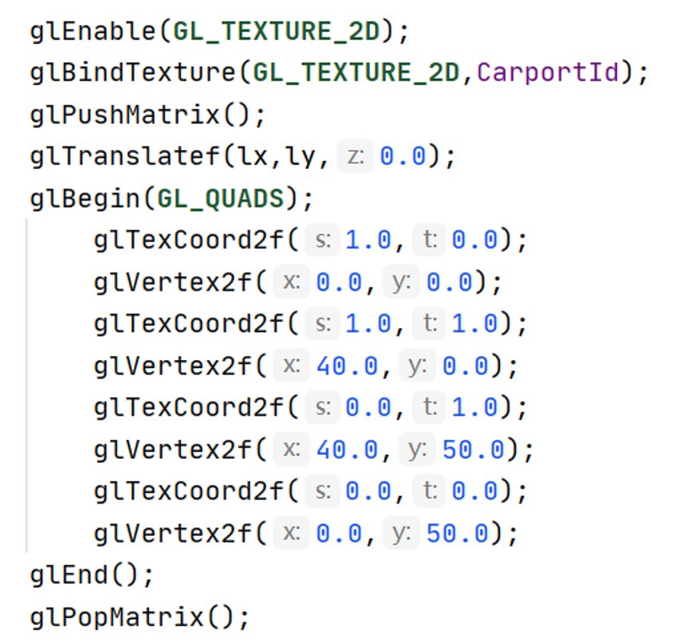
Texturing -yuxin Yang
OpenGL is a state machine, all States must have a beginning and an end, otherwise there will be problems. The same is true for texture display.
Before applying the texture, select
glEnable (GL_ TEXTURE_2D);
After the application,
glDisable (GL_ TEXTURE_ 2D);
display and define the shape:
glBegin (GL_QUANDS);
after the display, glEnd().
Each state starts and ends one by one.
for other, glVertex() defines the vertex,and glTexCoord2f() defines the coord.and also ,we can use these two fuctions to change the Rotation angle of the figure.
In the texture code on the left, the texture is stretched by s-axis and T-axis.

Slide 10
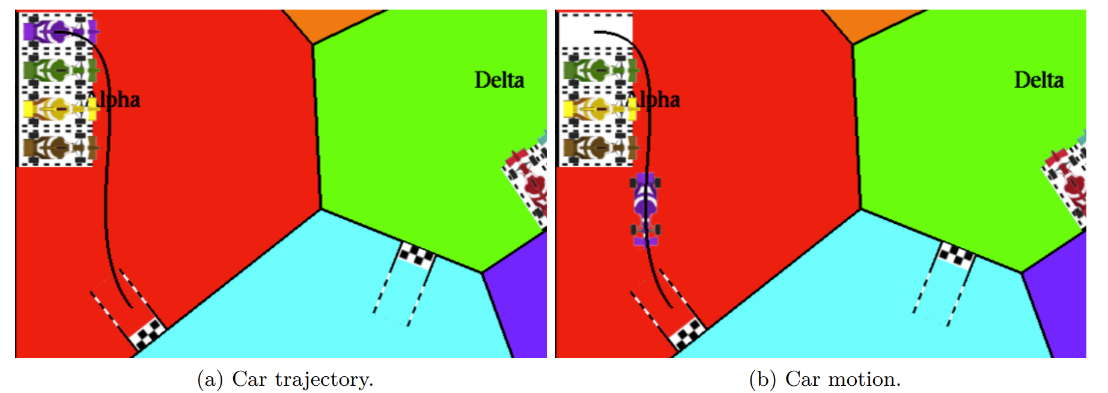
Car Movement -asonye Ajachukwu
For the car motion, we calculate the length of the curve in which the car would pass through in order for it to move, pass through the door using the shortest path and getting into the car parking.
We consider that we have dt which is the delay since the previous motion and the constant velocity (velocity) of the car. We can deduce the length of the travel d = velocity × dt. The next step consist in computing Pi(t) and Pj (t+) two positions on the curve, and reduce d with the length of PiPj
This is achieved using the void TinyToyCars : : onUpdate ( d ouble dt )function

Slide 11

Thank you!

